Slide 1
Starting a MAgPIE run
First steps to running MAgPIE
Presenter: Edna J. Molina Bacca
mbacca@pik-potsdam.de
April 11th, 2024

Slide 2
Outline
Overview of the magpie folder
Starting MAgPIE
Execution steps
Common errors you might encounter
Cancel a model run

Slide 3
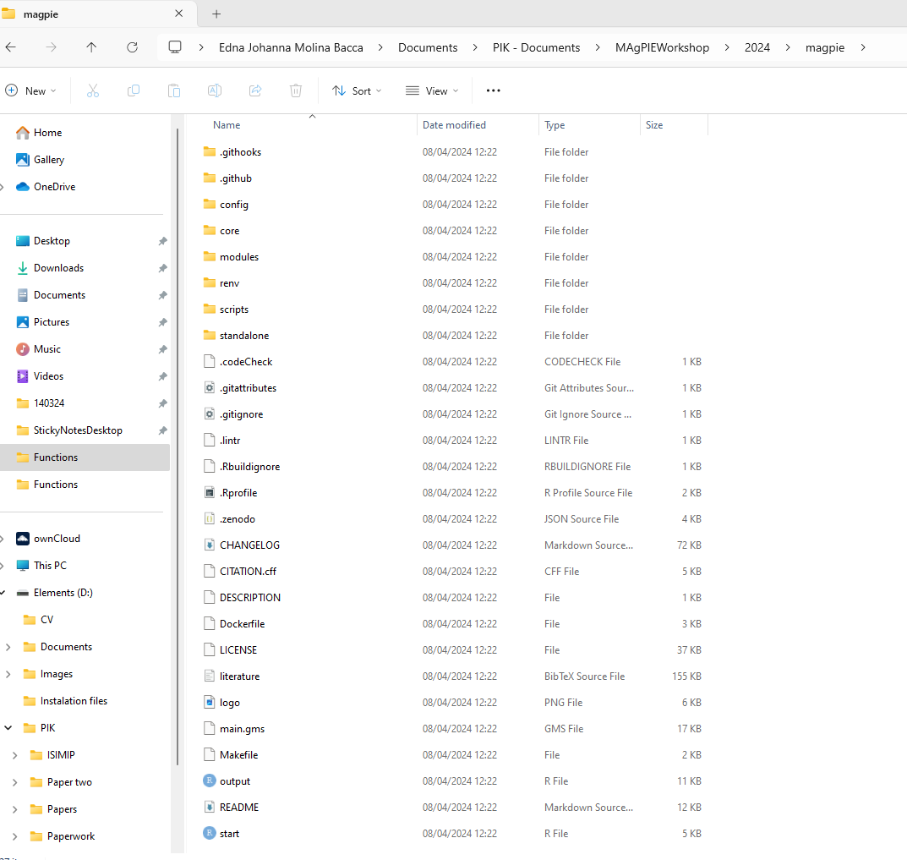
Overview of the magpie folder
.git folders: git-related folders
config: Default and scenario configurations
core: Core definitions of the model
modules: GAMS code
renv: For managing required R packages
scripts: Calibrate, start, post processing MAgPIE
standalone: Individual module operation
Auxiliary files: Git related, version control, license, main.gms, and the start.R and output.R scripts among others
Start script is the one we run in the cmd, shell or MacOS to start a magpie run
+ output folder once you have run MAgPIE

Slide 4
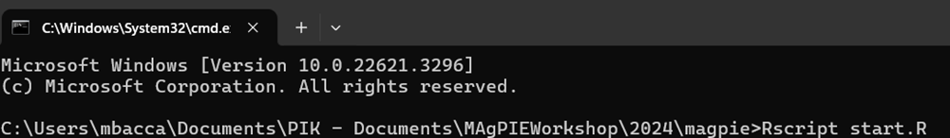
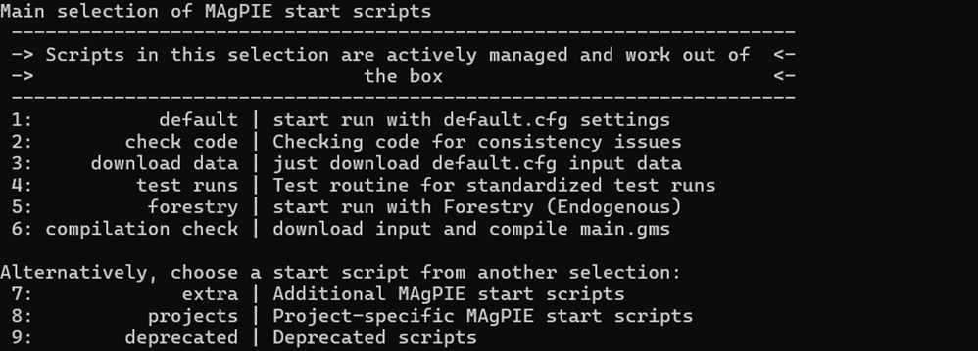
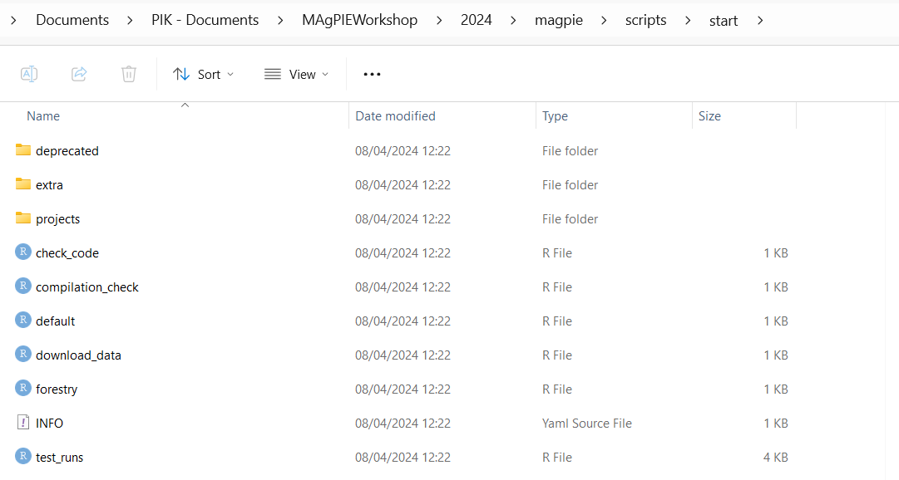
Starting MAgPIE and execution steps
To run the model, execute within a terminal in the main magpie folder of the model Rscript start.R, or within R source(“start.R”)
Checks for updates of the required R packages
Asks to select the Start script you want to run (MAgPIE with the desired configurations)
You can add your own run scripts by saving them in the folder: ./scripts/start/[specific sub-folder]/
After selection, it will ask you the submission type
Background execution will start the model as a job in the background.
Debug mode is similar to normal Direct execution.
If you run the code on a high performance cluster handling jobs with SLURM, you maybe also get a 4. and 5. option for job execution. `SLURM [priority/standby]

Slide 5
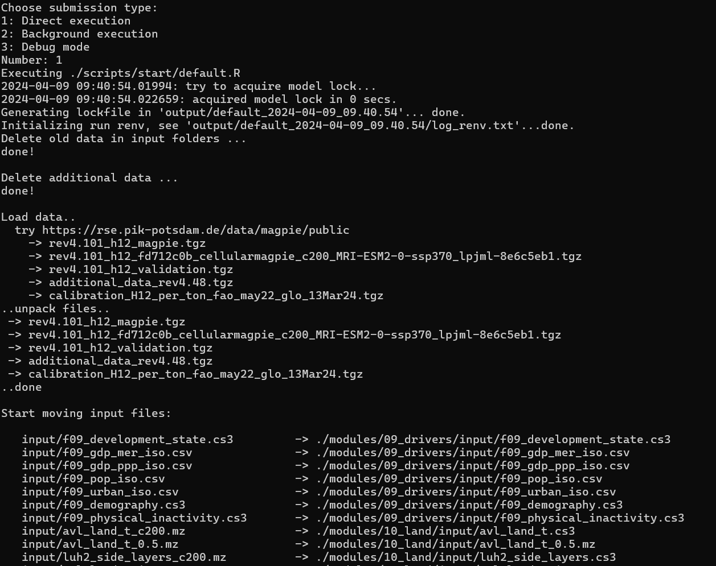
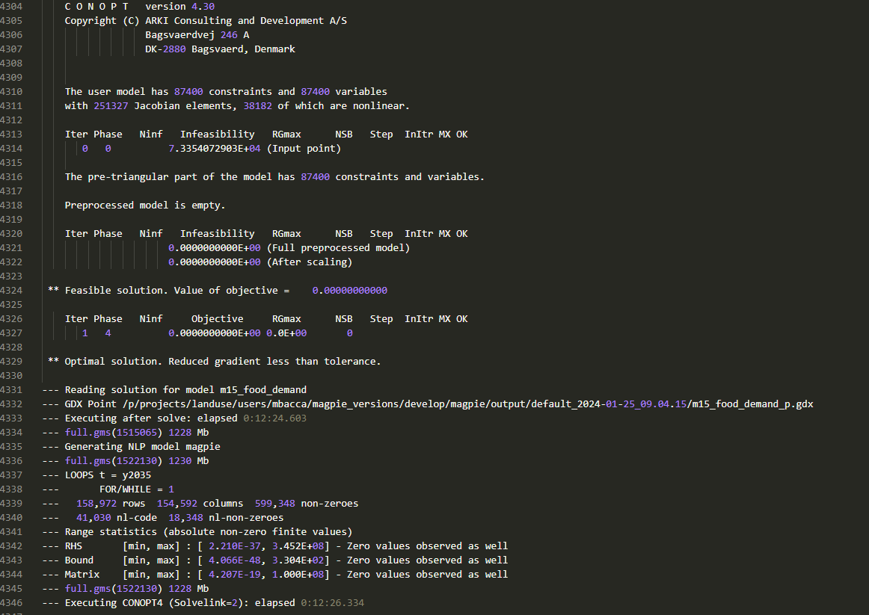
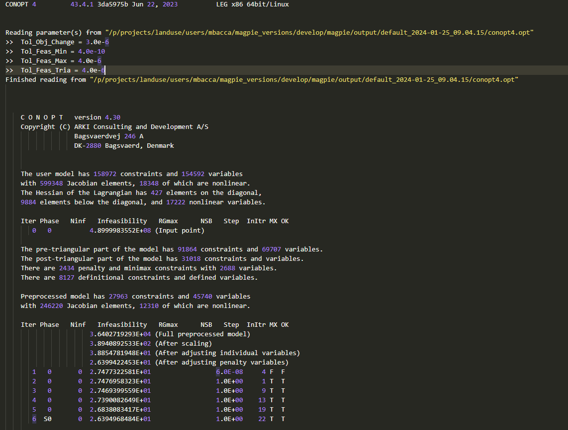
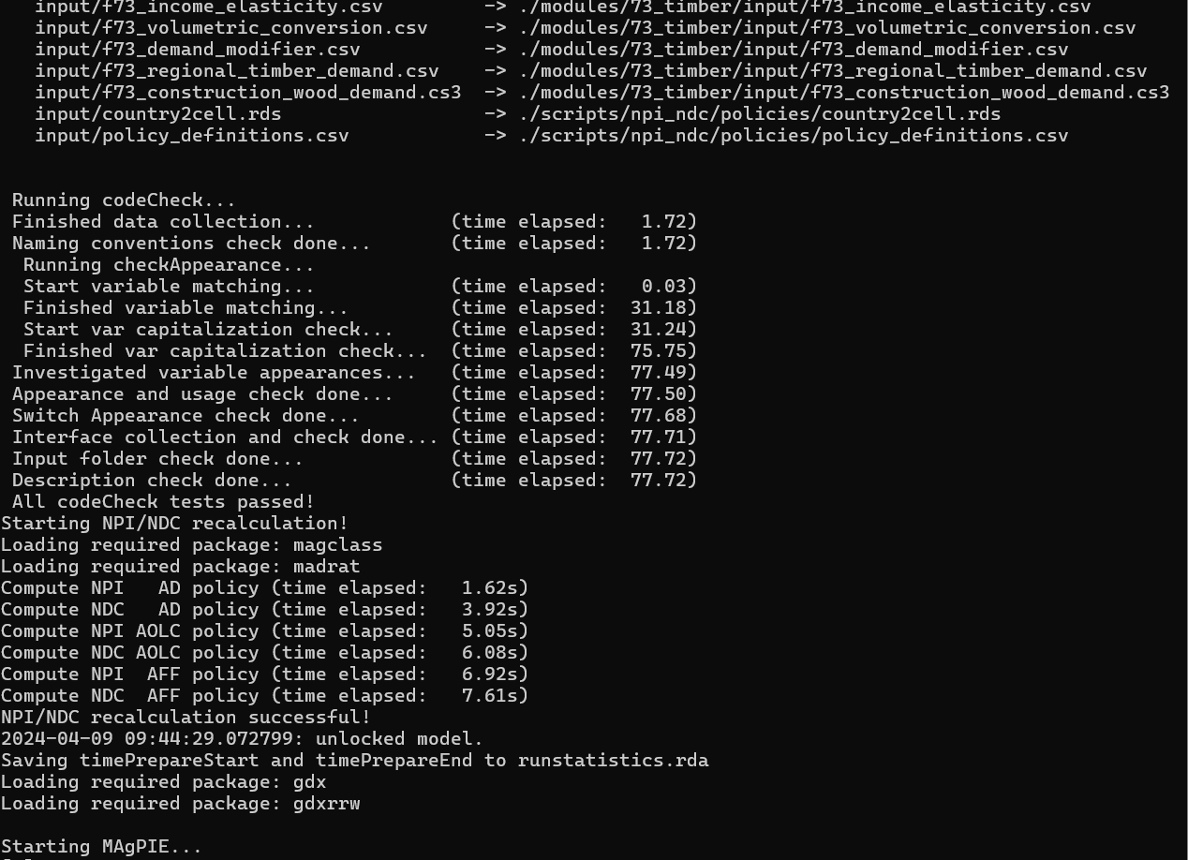
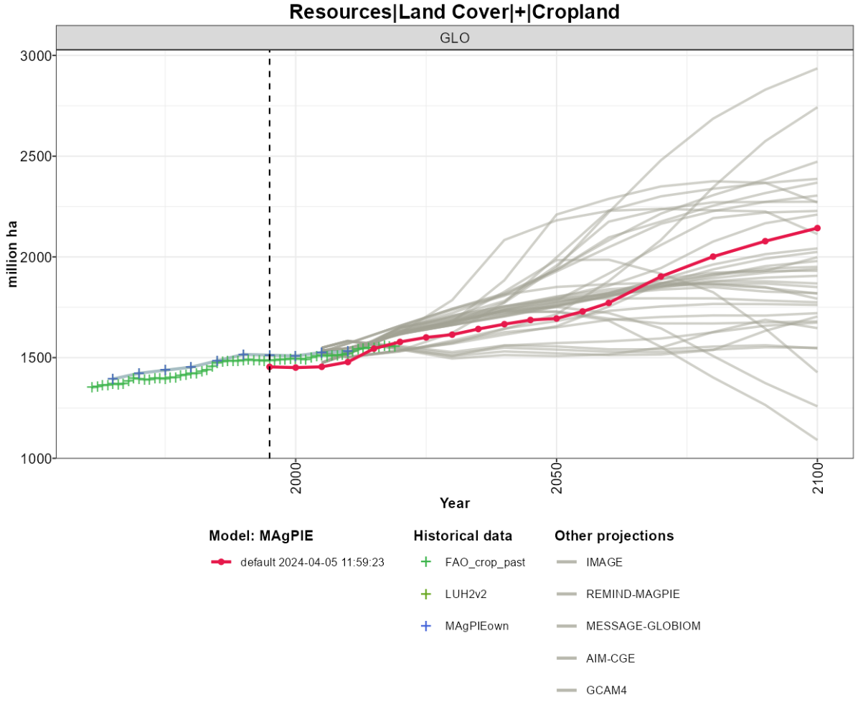
Execution steps
full.log file (output folder)
1. Pre-processing
1.1 Job submission and lock
2. GAMS model execution
2.1 Code compilation
3.Postprocessing
3.1 Submit run statistics
1.2 Runs renv (log_renv.txt)
1.3 Manages input data
1.4 Code check
1.5. NPI and NDC calculation
(calculates policy for protecting different land pools)
1.6 Calibration (if needed)
1.7 GAMS code submission and unlock
2.2 Code execution for each time step.
Solve food demand model
Iterate food demand and magpie model (if elastic demand is selected)
3.2 Execute configured output scripts (rds_report.R, output_check.R, disaggregation.R)
Solve magpie model
*
*
*

Slide 6
Common errors you might encounter
Missing path variables (R and GAMS)
Code check (changes in code like sets and variable definitions)
Missing files (access to repositories, changes in GAMS inputs, configuration of folders…)
Submission of run statistics (No access to repository-not critical)
Once you become an expert MAgPIE developer:
Infeasibilities (GAMS code)
You‘ll find specific information in the full.log and the full.lst files (in the output folder of your run). In case of doubts, check https://github.com/magpiemodel/magpie/discussions

Slide 7
Cancel a model run
The model can be stopped with Crtl + C.
If you run it in background mode you have to kill the job over the Task Manager or process handler (linux: top).

Slide 8
Thank you
mbacca@pik-potsdam.de

